Slide 1
DMDD Project Group 7
Topic: OTT Subscription Model

Slide 2
Our Team
Shubhada Bagal - 002962718
Kaustubh Khedekar - 002922222
Sanket Bansal - 002969158
Monica Choudhari - 002957299
Yichi Zhang - 002191084

Slide 3
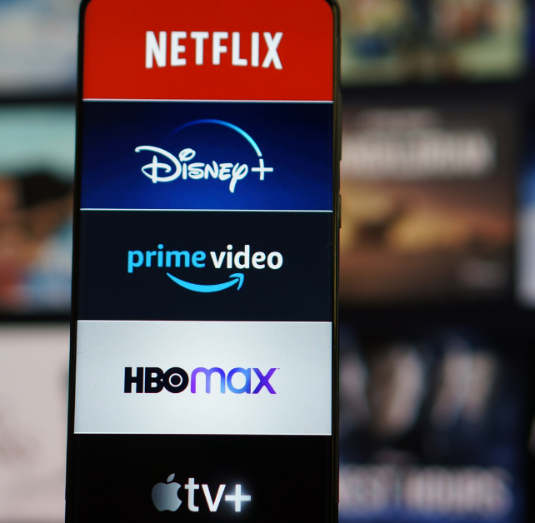
Project Introduction
Design and implementation of relational
database for OTT Subscription Business
01
Subscriber Management
To create and manage the user database and tracking their login activities, views, likes and dislikes
02
Content Management
Managing the purchase of content tracking the record of their expiry and user preferences
03
Advertising Management
Dealing with the third-party organization to promote their content in our platform
04
Performance Management
Helping the business owner to evaluate business performance and making growth strategies

Slide 4





Finding out the trending content to increase the user engagement
To analyze the revenue generated by the business owner by selling the subscription and advt.
User
Expenses
Profits
Data
Growth
To analyze the investment made by the business owner for buying the content rights
Easy modification of content by avoiding duplication
To analyze the location wise subscriber growth and make the strategies for the low performing areas
Business Problem Addressed
In our model we have tried to cover every possible aspect to enhance the business growth, performance, profit and increase the user engagement

Slide 5
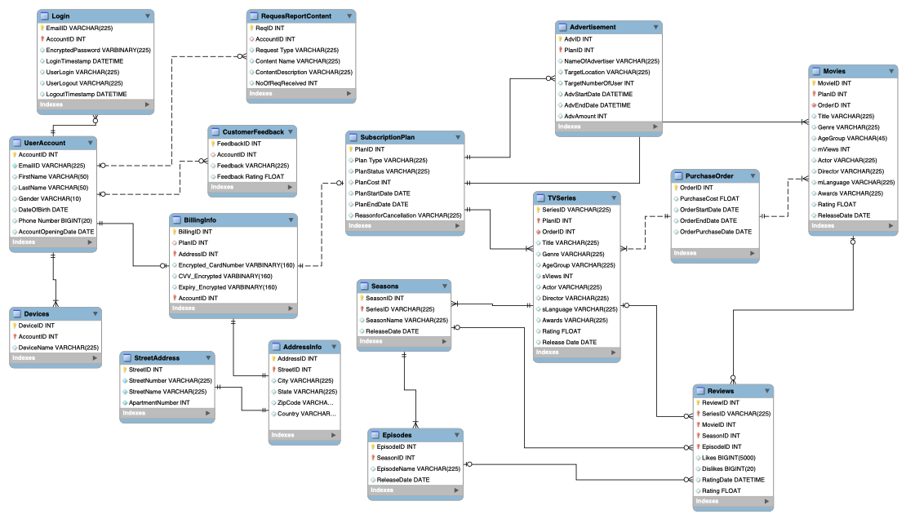
Entity Relationship Diagram

Slide 6
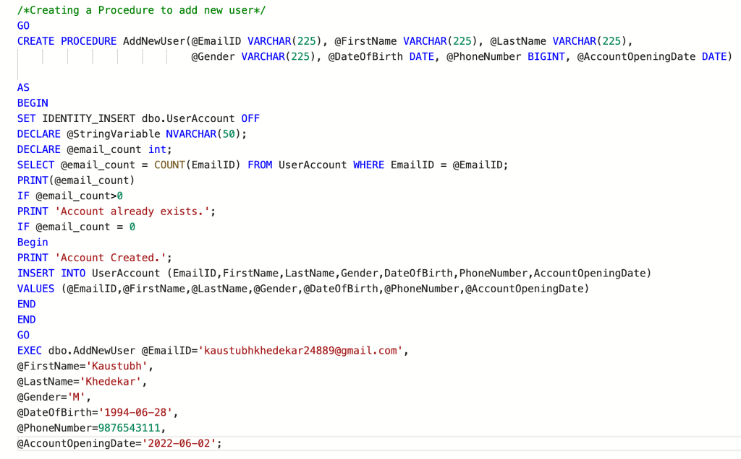
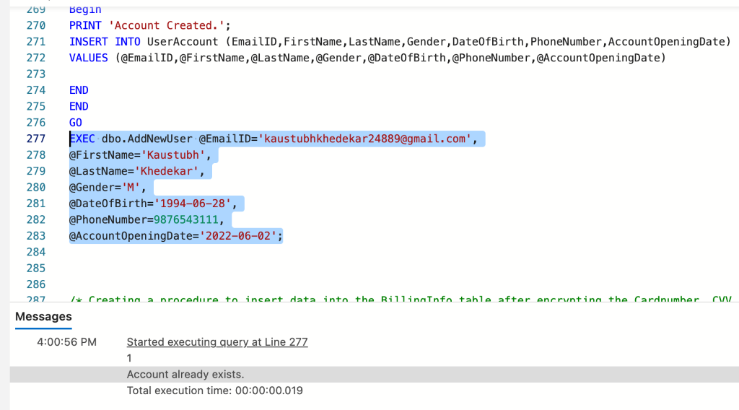
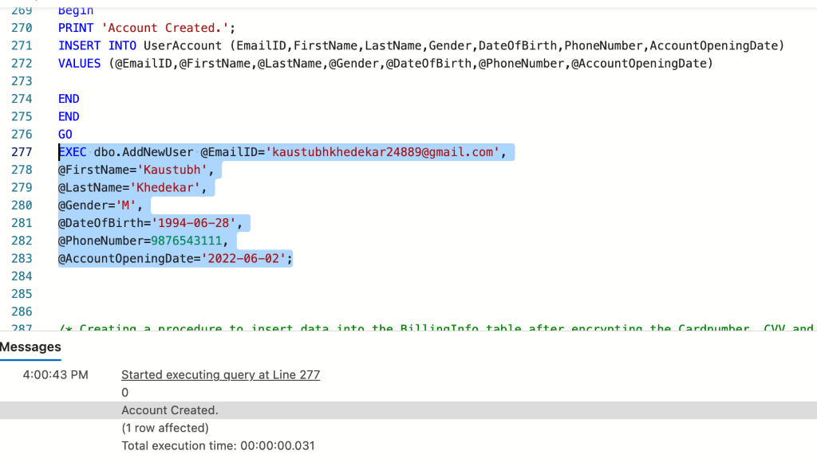
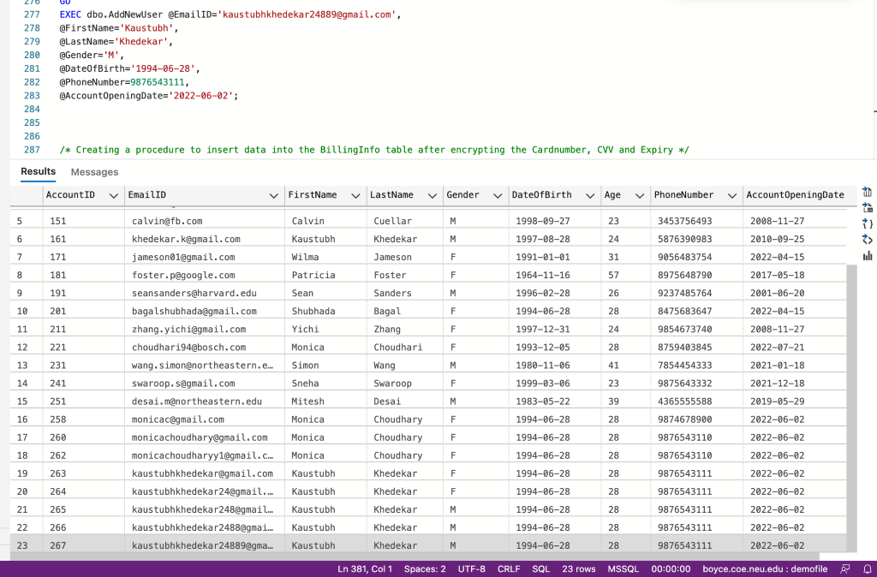
SQL DDL – Stored Procedure
Script for Adding New User Stored Procedure:
Adding the Same User for 2nd Time using the Stored Procedure: Duplicate Account Not Created since Account Already Exists.
Executing the Stored Procedure to Add a New User: New User Added/Account Created

Slide 7
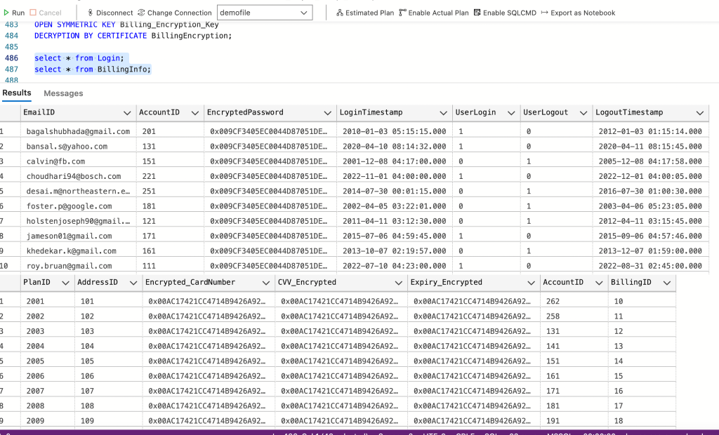
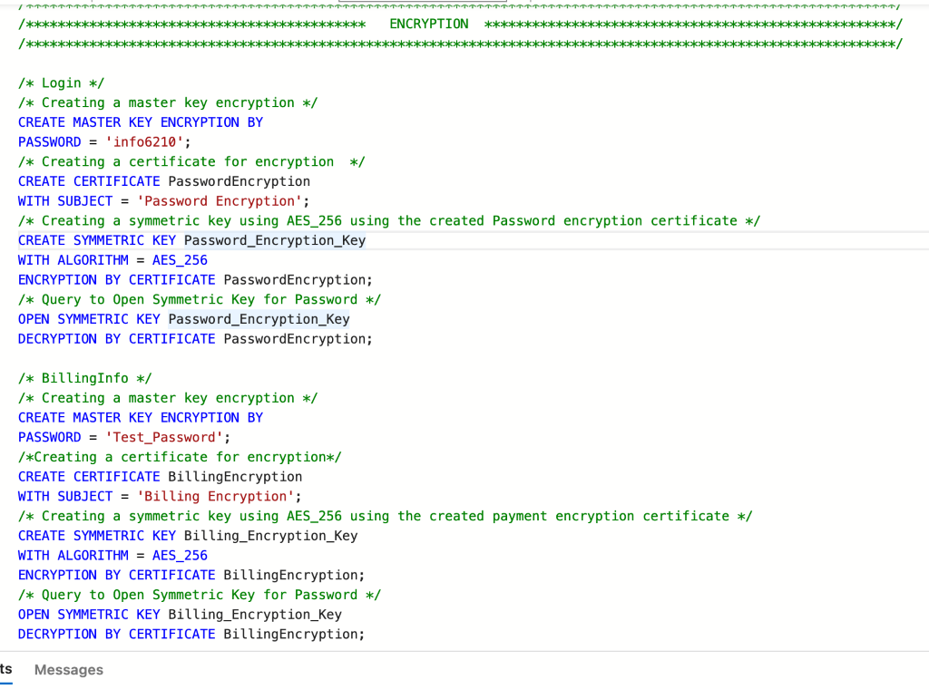
SQL DDL – Encryption
Encryption on BillingInfo and Login Table:

Slide 8
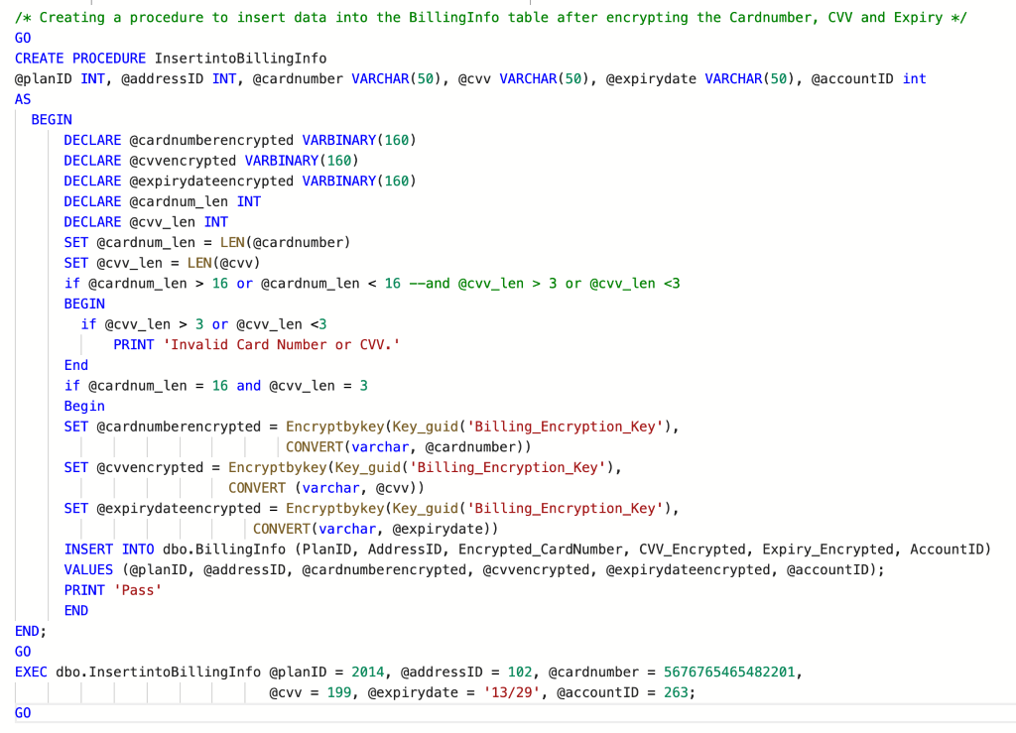
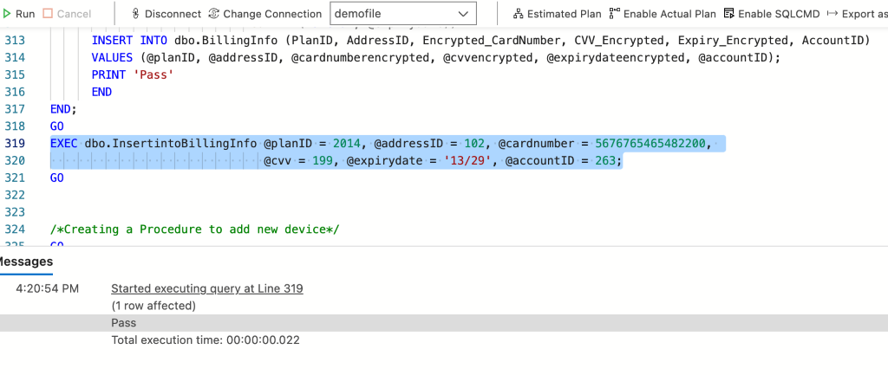
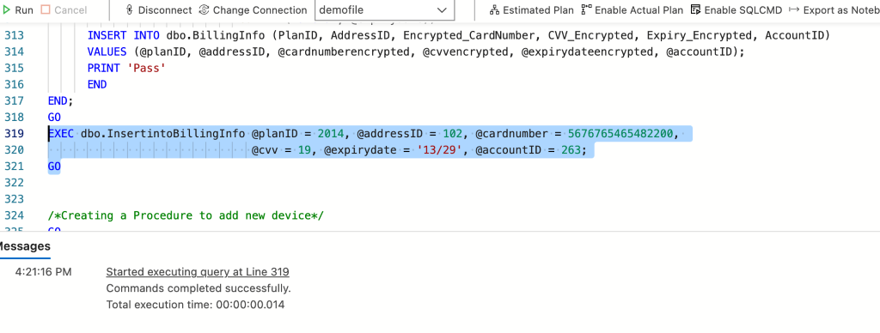
SQL DDL – Data Validation
Script for Adding BillingInfo Details:
After Execution: Data Added to BillingInfo Table Since all Data Entered Was Correct.
After Execution: Data Not Added to BillingInfo Table Since Data Entered Wasn't Correct.

Slide 9
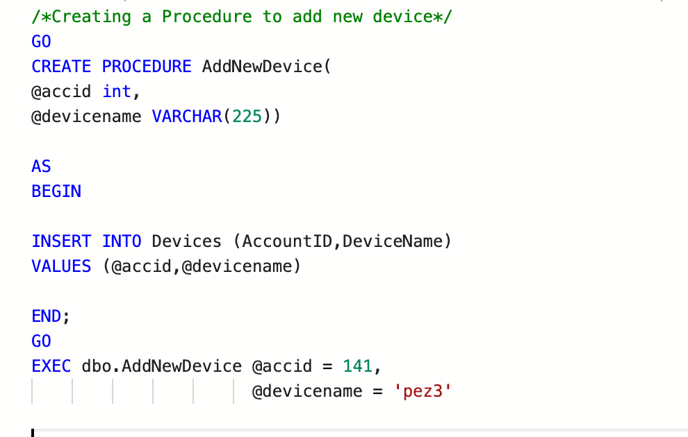
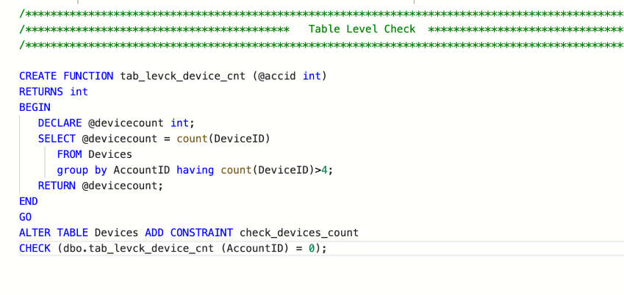
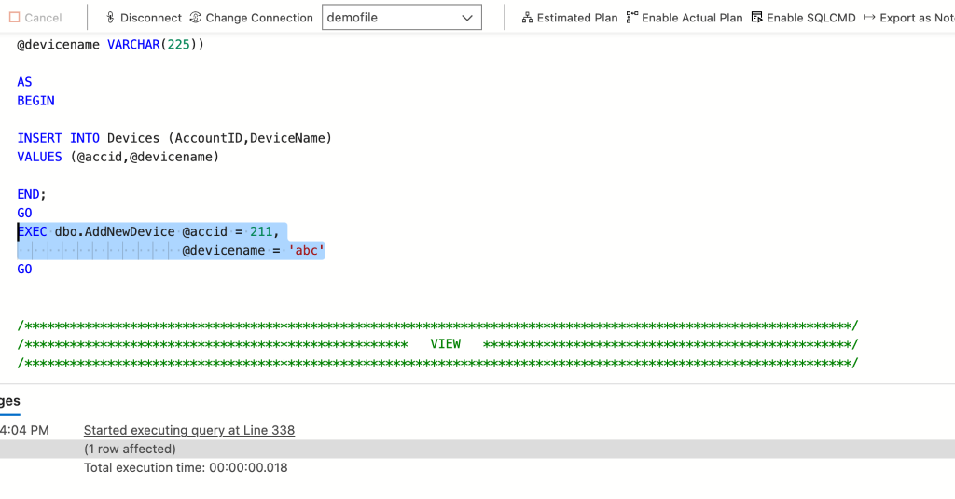
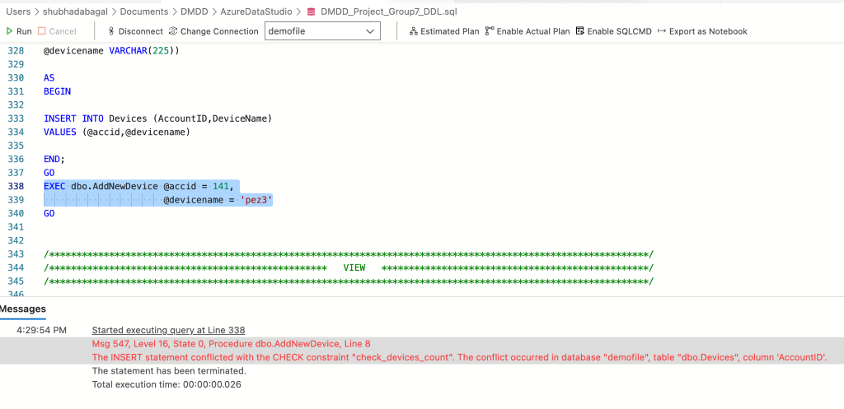
SQL DDL – Table-level CHECK
Script to Add New Device:
Table-Level constraint Added:
After Execution: Device Added
After Execution: Device Not Added As The User Adding The Device Already Has 4 Devices Registered:

Slide 10
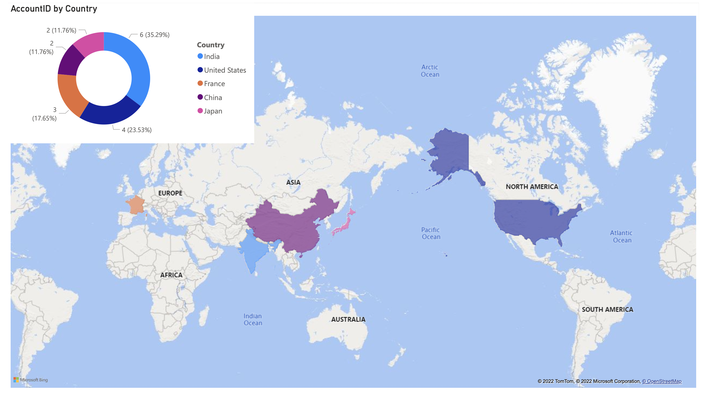
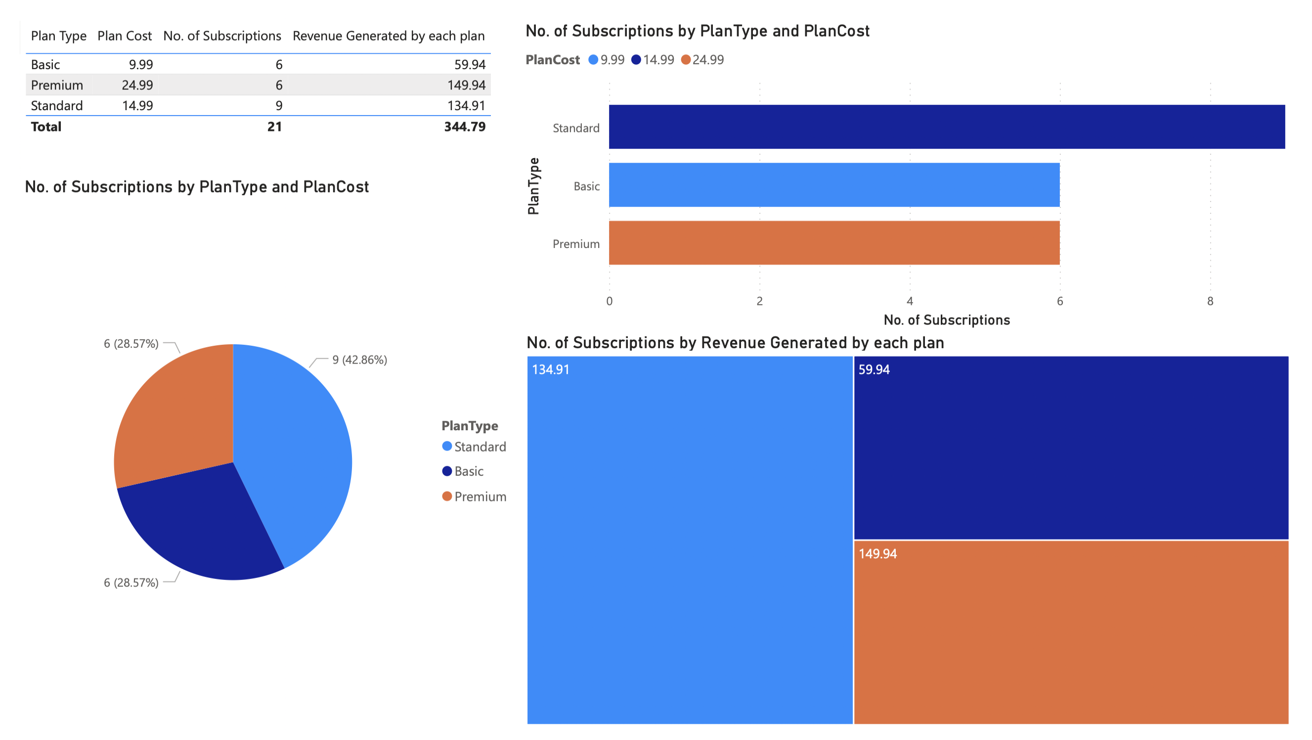
PowerBI Visualization
Plan wise Revenue Generated
Country wise number of Subscribers

Slide 11
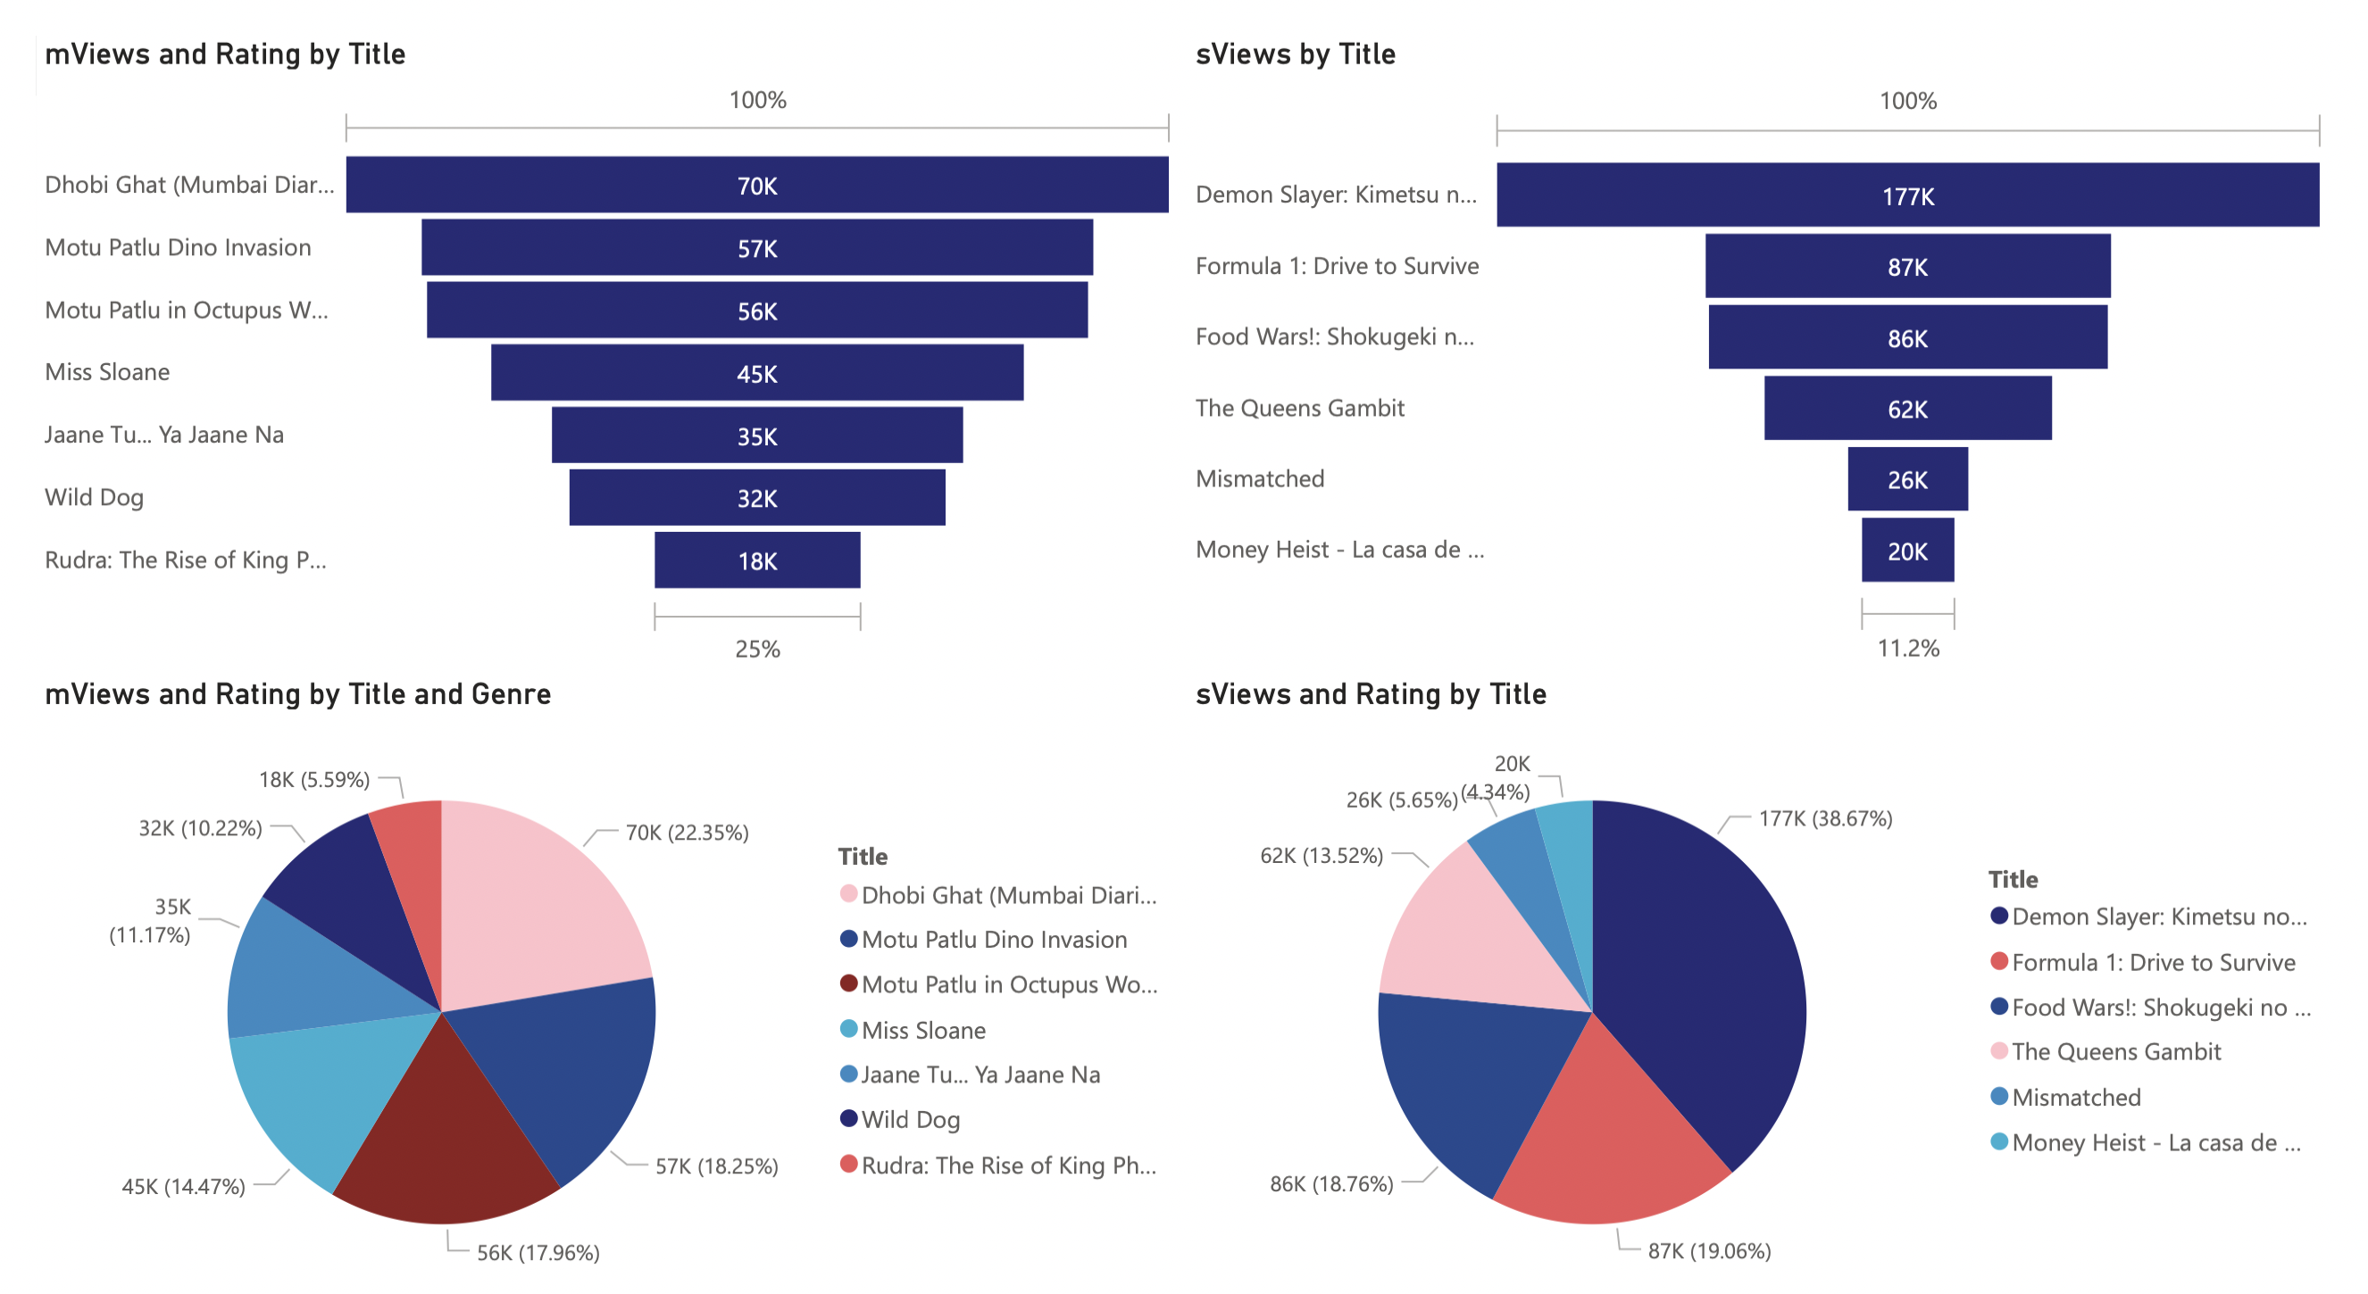
PowerBI Visualization
Views & Ratings of Contents

Slide 12
Project Summary
1
User Engagement
4
Profits Generation
With the project database we can evaluate the user engagement and target the country or area having low engagement rate.
We are having two different sources of revenue generation in our database i.e., by selling Advertisement and Subscription Plan and we are tracking the income against the investment made to get the profit summary.
2
Content Track
5
Safety and Security
With content track we can track the performance of each content and accordingly populate the suggestions to the user to increase the subscription rate and remove the low performing contents.
We have encrypted all the sensitive user information and given checks or validation in all the tables to make it more secure for the best interest of users and business owners
3
Investment Details
6
Business Reporting
With this data we can track the record of all the investments made on the purchase of different movies and tv series accordingly we can put a break or speed up the investments based on business performance.
To keep the business growing and make the platform more user friendly we have formed different views to evaluate the performances of business based on content, profit, user views, user feedback, location, etc.

Slide 13
THANK YOU!

